Slide 1
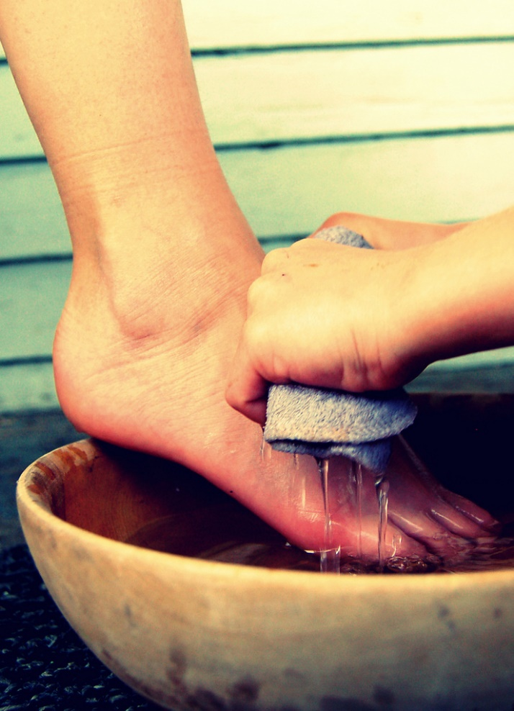
Christians are Servants!
Romans
6:15-23
Notes:
(doulos – voluntary or involuntary, so it carries with it the idea of subjection or subservience)
Each of us are slaves (to whom are we bound?)
If to Christ, there are blessings (see 23)
If to Christ, there are ramifications (see 19)

Slide 2
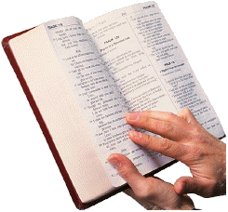
1 Corinthians 6:19-20
Or do you not know that your body is the temple of the Holy Spirit who is in you, whom you have from God, and you are not your own? ²⁰ For you were bought at a price; therefore glorify God in your body and in your spirit, which are God's.
(7:23), You were bought at a price; do not become slaves of men.
Notes:
The price was the blood of Jesus, shed on the cross for our sins.
Our response must be to glorify God in your body and spirit (living for Jesus)
Our response, we must not serve men, rather God
IN FACT…. (Next Slide)

Slide 3
Christians must not serve…
Sin
John 8:34
Mammon
Matthew 6:24-25
Their own Belly (desires)
Titus 3:3
The creature rather than the Creator
Romans 1:22-25
Notes:
(John 8:34), “Jesus answered them, ‘Most assuredly, I say to you, whoever commits sin is a slave of sin.’”
(Matthew 6:24-25), “No one can serve two masters; for either he will hate the one and love the other, or else he will be loyal to the one and despise the other. You cannot serve God and mammon.”
Mammon – wealth or money, a condemnation of greed (which controls)
(Titus 3:3), “For we ourselves were also once foolish, disobedient, deceived, serving various lusts and pleasures, living in malice and envy, hatefull and hating one another.”
(Romans 1:22-25), “Professing to be wise, they became fools, ²³ and changed the glory of the incorruptible God into an image made like corruptible man—and birds and four- footed animals and creeping things. ²⁴ Therefore God also gave them up to uncleanness, in the lusts of their hearts, to dishonor their bodies among themselves, ²⁵ who exchanged the truth of God for the lie, and worshiped and served the creature rather than the Creator, who is blessed forever. Amen.”

Slide 4
Christians must serve…
God
Matthew 4:10
Christ
John 12:25-26
Righteousness
Romans 6:19
One Another
Galatians 5:13
All men
1 Thessalonians 5:15
Notes:
(Matthew 4:10), “Then Jesus said to him, ‘Away with you, Satan! For it is written, 'You shall worship the Lord your God, and Him only you shall serve.'“
(John 12:25-26), “He who loves his life will lose it, and he who hates his life in this world will keep it for eternal life. ²⁶ If anyone serves Me, let him follow Me; and where I am, there My servant will be also. If anyone serves Me, him My Father will honor.”
(Romans 6:19), “I speak in human terms because of the weakness of your flesh. For just as you presented your members as slaves of uncleanness, and of lawlessness leading to more lawlessness, so now present your members as slaves of righteousness for holiness.”
(Galatians 5:13), “For you, brethren, have been called to liberty; only do not use liberty as an opportunity for the flesh, but through love serve one another.”
(1 Thessalonians 5:15), “See that no one renders evil for evil to anyone, but always pursue what is good both for yourselves and for all.”

Slide 5
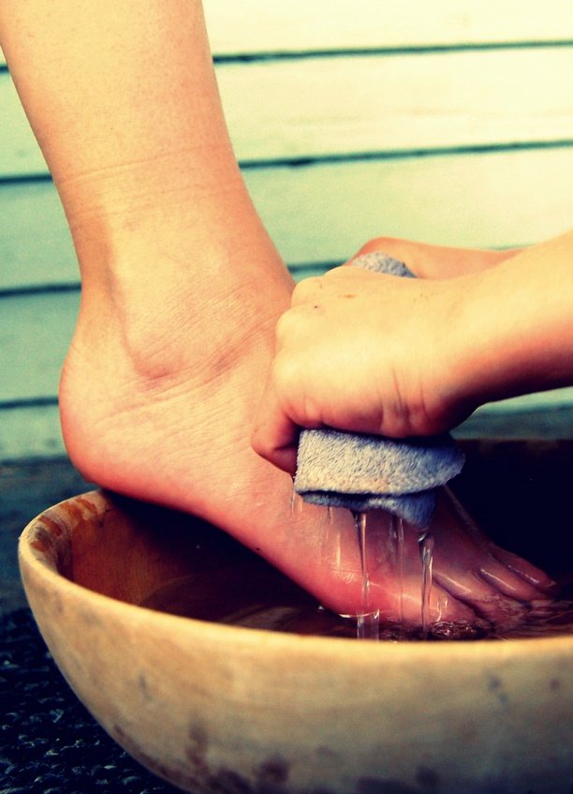
Our service to God must be characterized by total devotion!
Philippians
2:19-22
Notes:
(Philippians 2:19-22),
“But I trust in the Lord Jesus to send Timothy to you shortly, that I also may be encouraged when I know your state. ²⁰ For I have no one like-minded, who will sincerely care for your state. ²¹ For all seek their own, not the things which are of Christ Jesus. ²² But you know his proven character, that as a son with his father he served with me in the gospel.”

